Slide 1
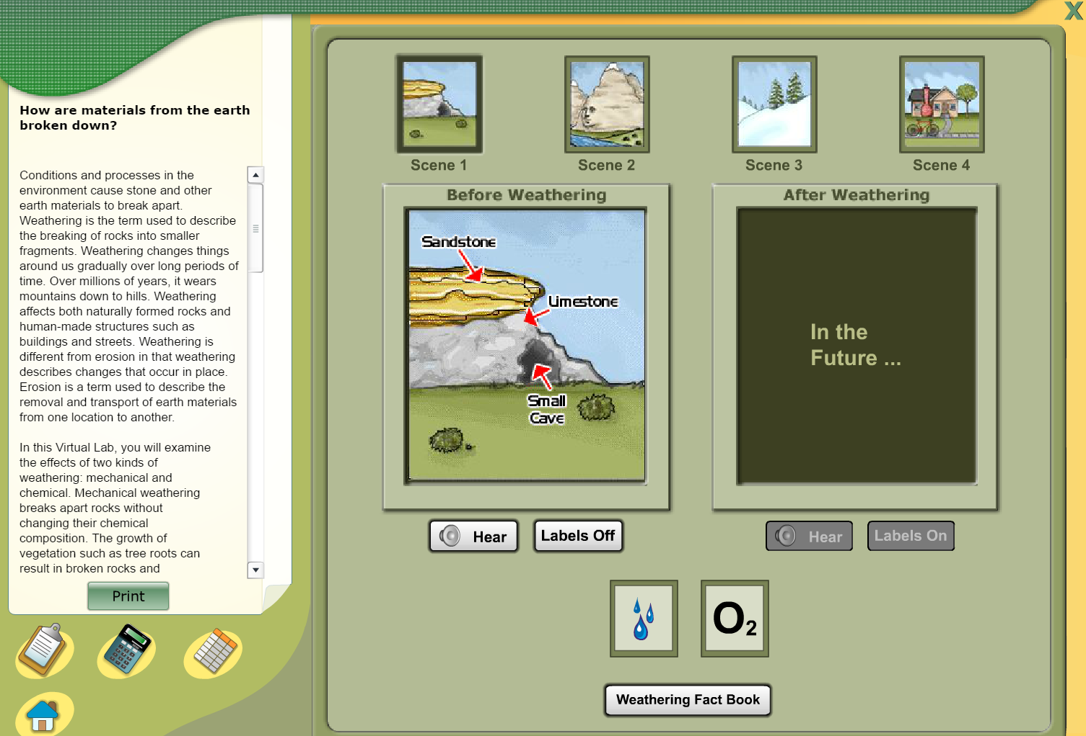
http://www.glencoe.com/sites/common_assets/science/virtual_labs/E06/E06.html

Slide 2
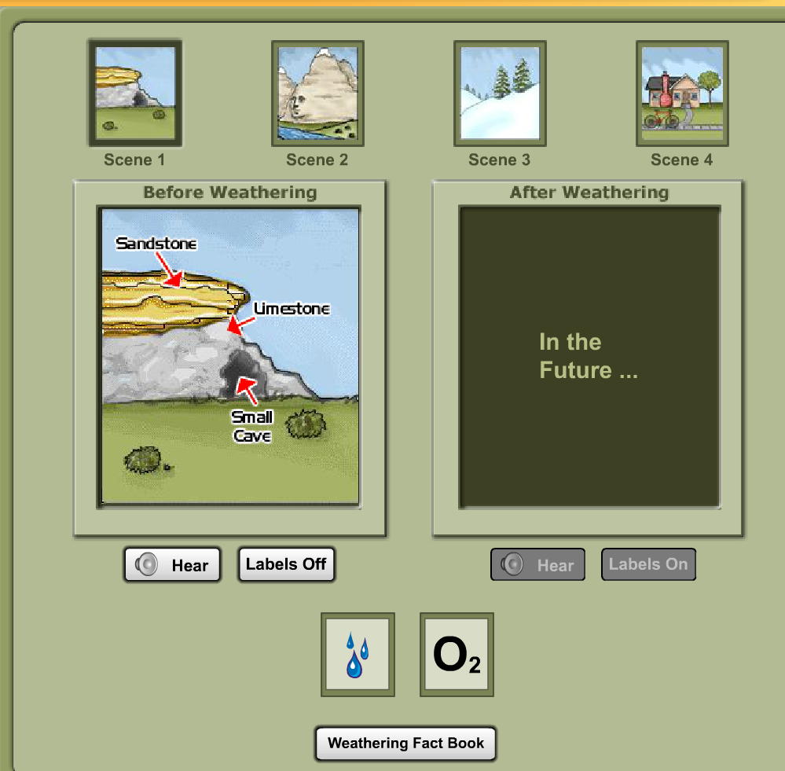

Slide 3
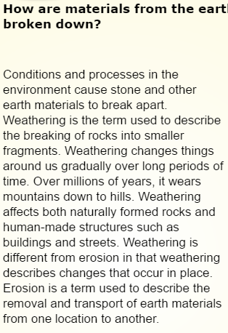
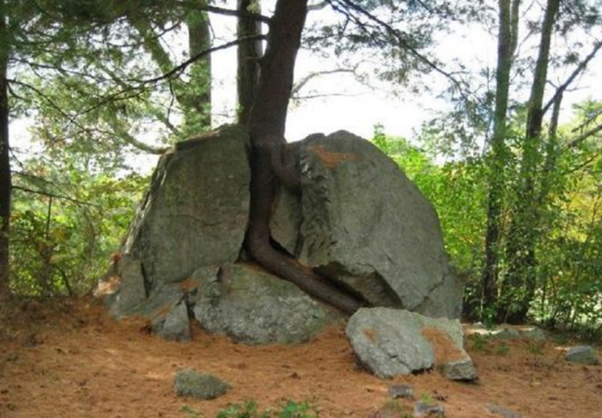

Slide 4
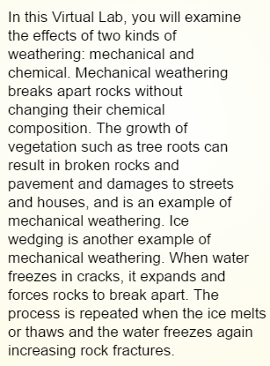
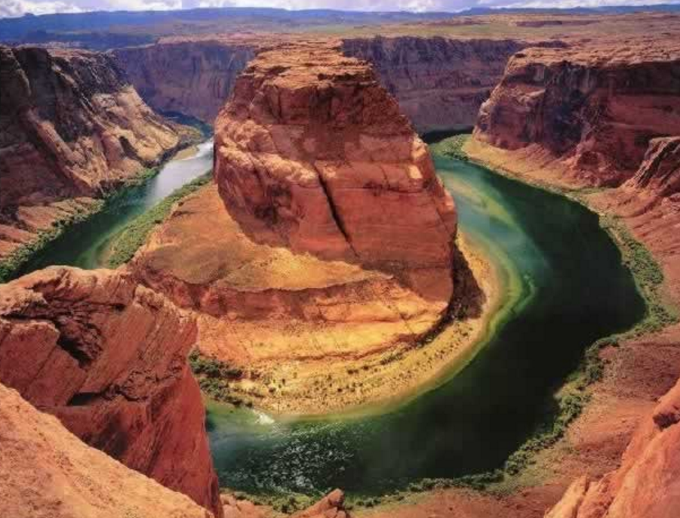

Slide 5
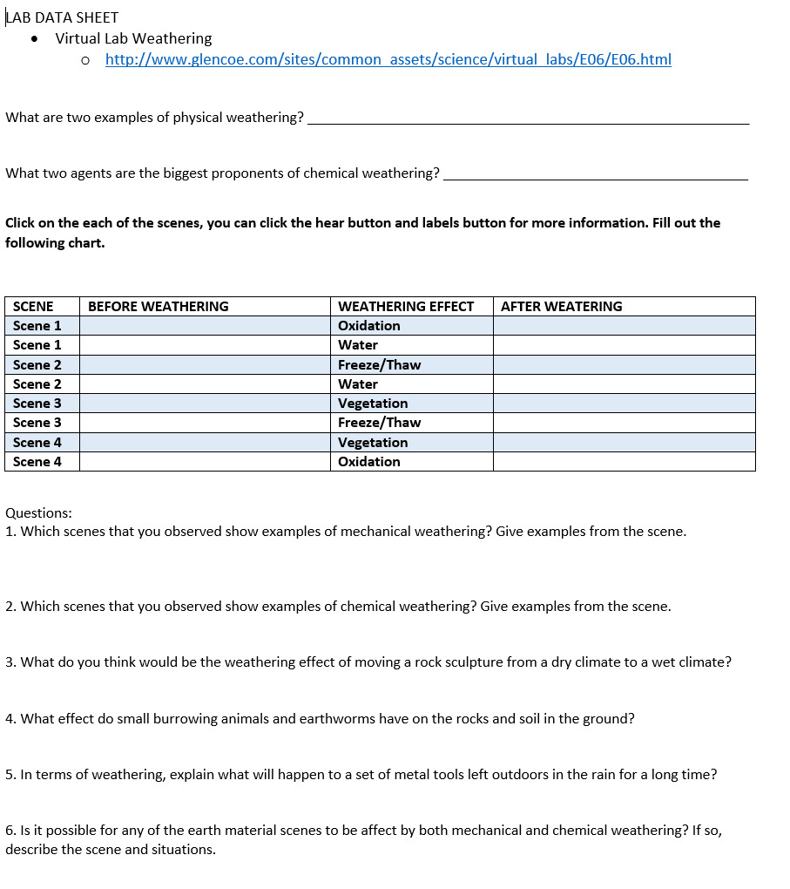
TeacherWeb.Com/Fl/VeniceMiddleSchool/Fuerst
First open data sheet. Go to 6th grade assignments. Open Virtual Lab Data Sheet
Then when data sheet opens, click on blue link to virtual lab and begin

